Slide 1

Applications of Data Mining

Slide 2
Data Mining is a step in KDD process. KDD (Knowledge Discovery in Databases) applications deliver measurable benefits, including reduced cost of doing business, improved profitability, and enhanced quality of service. Industries, in which such benefits have been demonstrated, include insurance, direct-mail,marketing,telecommunications, retail, and health care.

Slide 3
Market Management: Target marketing, customer relationship management, market basket analysis, cross-selling, market segmentation.
Risk Management: Forecasting, customer retention, improved underwriting, quality control, competitive analysis.
Fraud Management: Fraud Detection.
Industry-Specific Applications: Banking, finance, and securities:Profitability analysis (for individual officer branch, product, product group,

Slide 4
Telecommunications and Media: Response scoring, marketing campaign management, profitability analysis, and customer segmentation.
Health Care: FAMS (Fraud and Abuse Management System) assisting health insurance organizations dealing with fraud and abuse: detection, investigation, settlement, prevention of recurrence

Slide 5

Business Applications Using Data Mining
Data mining has emerged this decade as a key technology for areas such as business intelligence, marketing, and so forth.
From a technical view, we do not consider data mining to be a new field, but rather another discipline in the lengthy history of engineering sciences that use data is a core focus for developing knowledge.

Slide 6
Ctd…
Data engineers work with physicists in analyzing spectral data measured from a high-resolution imaging spectrometer develop sophisticated models of the spectrometer’s complex error modalities (registration, response function, calibration, measurement glitches) so that a high-fidelity model of the spectrometer’s measurements can be developed.

Slide 7
Data engineers investigating the performance of an industrial strength place and- route package uncover useful characteristics of the optimization process and thereby improve the performance of the algorithm.
Data engineers work with astronomers in analyzing infrared data from an electronic star catalog.

Slide 8

Many organizations now employ Data Mining as a secret weapon to keep or gain a competitive edge.
Data Mining has been used in database marketing, retail data analysis, stock selection, credit approval, etc. For example, Mellon Bank, Pittsburgh - $40 billion financial services company, is applying IBM’s Intelligent Miner on its customer database in an effort to retain profitable customers.

Slide 9
Database Marketing is a very successful and popular business application of Data Mining. By mining historical customer databases, patterns and trends are extracted. Customer profiles are built from these results to produce more effective marketing.

Slide 10
Retail databases contain customer-shopping transactions. Data Mining can find customer-shopping patterns that can be used. For example, in a sales campaign. Association rule mining is very useful for such analysis.
Using Data Mining techniques, investors can build models to predict the performance of stocks. By searching trends and patterns in stock data, Data Mining can also help investors to find stocks with good performances.
Applications for credit or loan are decided based on the applicants’ information. A decision support model for credit or loan approval may be constructed from historical data using Data Mining tools.

Slide 11
Risk Management and Targeted Marketing
Insurance and direct mail are two industries that rely on data analysis to make profitable business decisions. For example, insurers must be able to
accurately assess the risks posed by their policyholders to set insurance premiums at competitive levels.

Slide 12
Businesses relying on data-driven analysis for decision making typically construct data warehouses to capture as much information as possible about their customers. Examples of such information include details of past customer transactions, as well as additional information obtained from third party data providers, including credit scores and demographics, for targeted marketing purposes and motor vehicle records for insurance purposes.

Slide 13
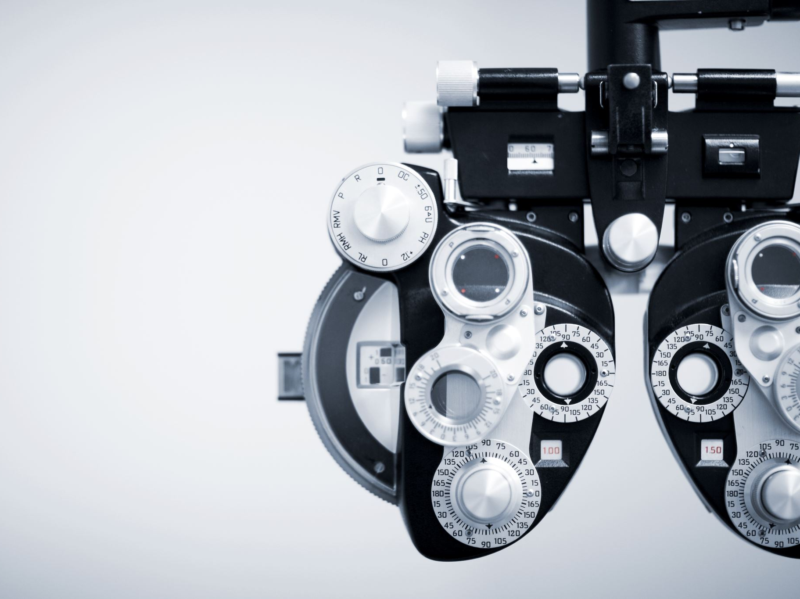
Medical Applications (diabetic screening)
Preprocessing and post processing steps are often the most critical elements determining the effectiveness of real-life Data Mining applications.
In 1990s in Singapore, about 10% of the population were diabetic, a disease with many side effects, including increased risk of eye disease, kidney failure, other complications.

Slide 14

Ctd…
However, early detection and proper care management can make a difference in health and longevity of individual sufferers.
For example, to combat the disease, the Government of Singapore introduced a regular screening program for diabetic patients in its public hospitals in 1992.
Patient information, clinical symptoms, Eye disease diagnosis, treatment, and other details were captured in a database maintained by Government medical authorities.

Slide 15
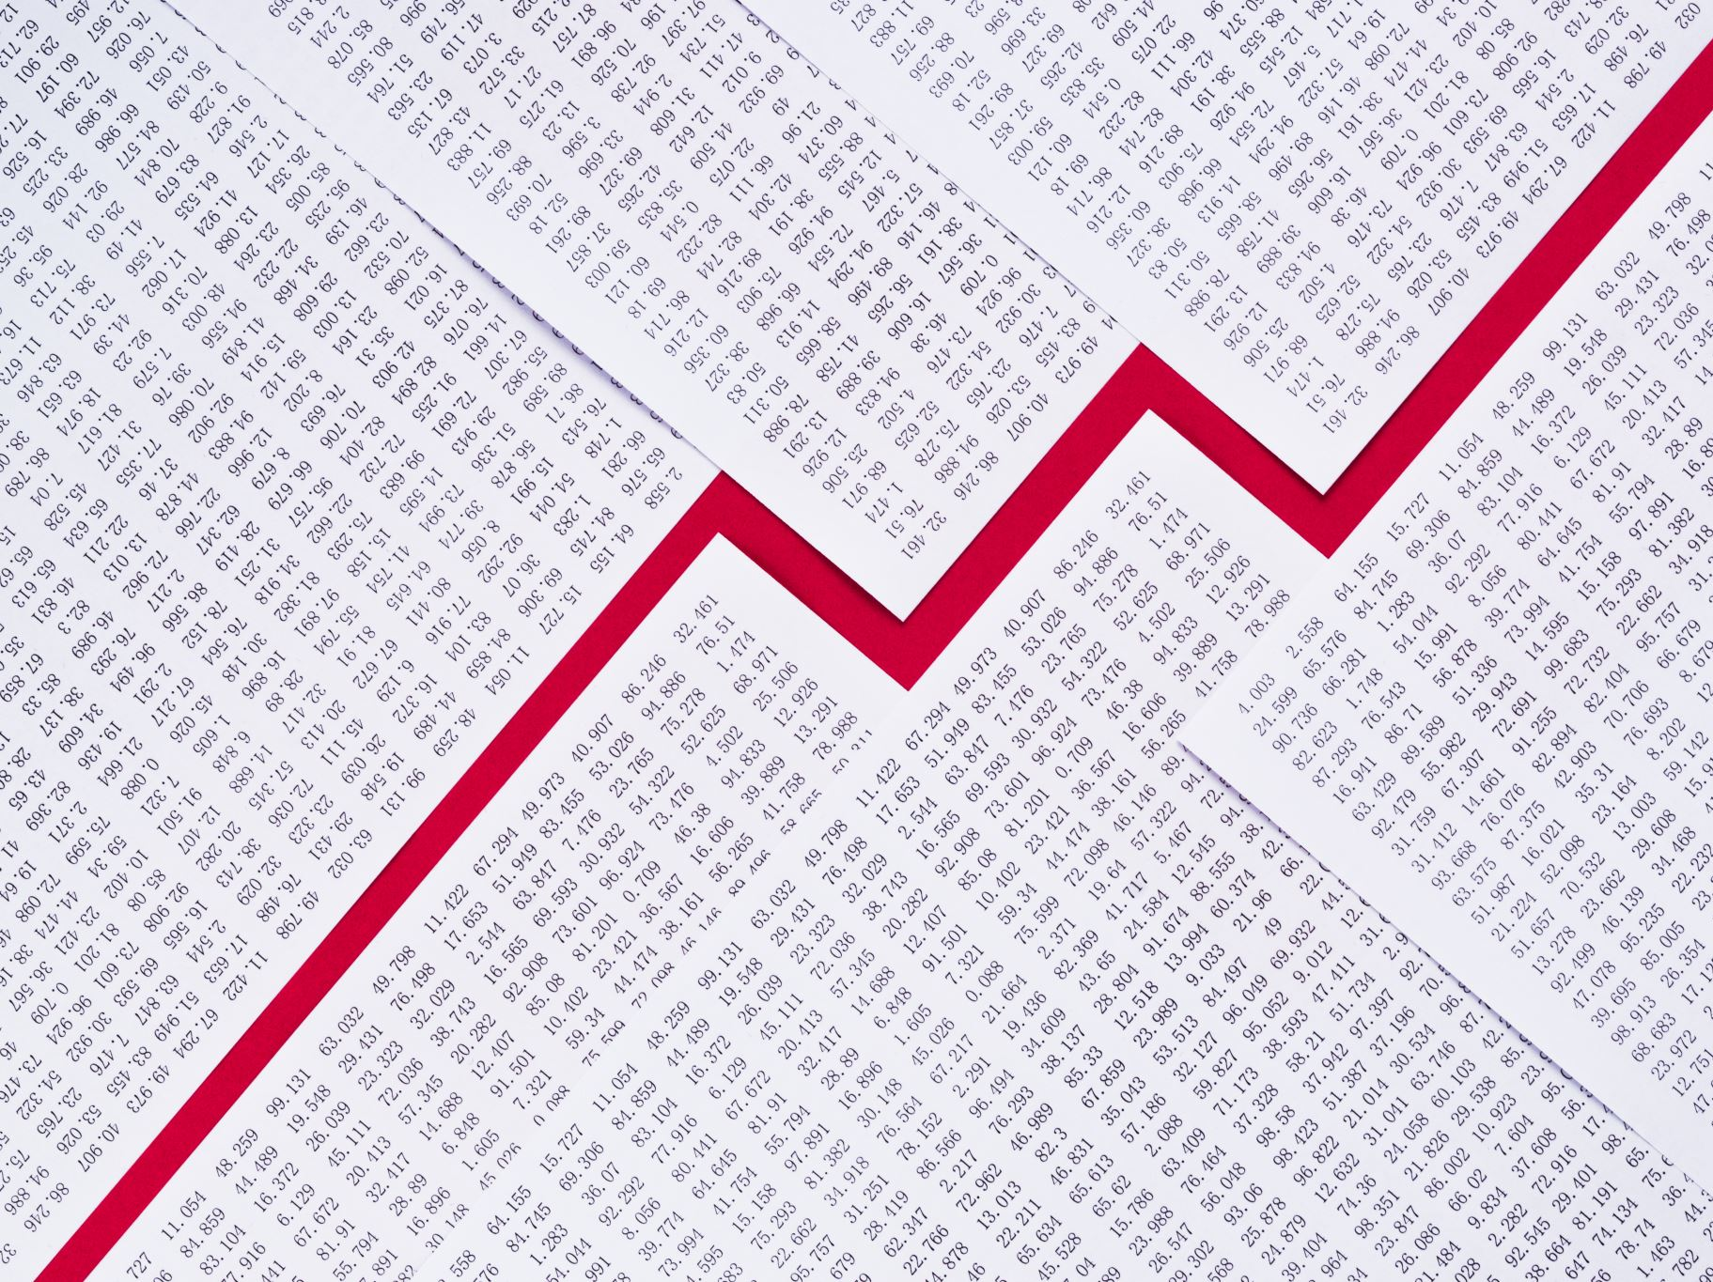
The second problem was that some state of the art association rule algorithms generate too many rules from the data, no matter how clean it is. Because physicians are busy seeing patients, they cannot take the time to sift through large numbers of rules. It was therefore important to present the discovered rules in some easy to understand form.

Slide 16
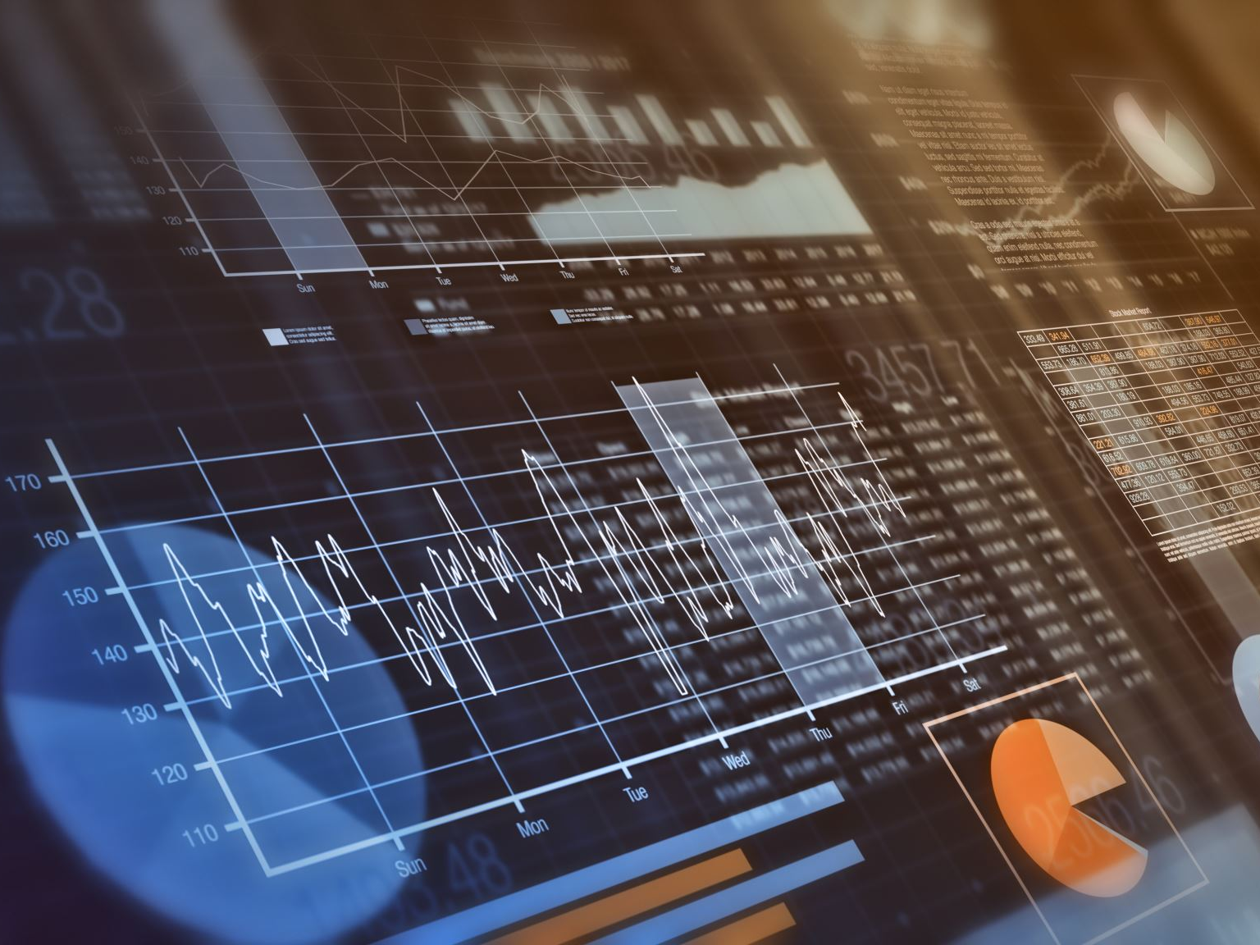
To overcome the problem noisy data, a Data Mining team at National University of Singapore developed a semiautomatic data cleaning system to reconcile database format differences by allowing physicians to specify the mapping between attributes in different format styles and/or different encoding schemes.
Reconciling the format differences addressed the problem of Identifying and removing duplicate records.

Slide 17
Scientific Applications Using Data Mining
Biomedical Engineering
The past decade has seen an explosive growth in biomedical research, ranging from the development of new pharmaceuticals and advances in cancer therapies to the identification and study of the human genome by discovering large-scale sequencing patterns and gene functions. In this section, the applications in biomedicine and DNA data analysis and an unsupervised neural network approach to medical data mining techniques and data mining-assisted decision support for fever diagnosis – case studies are presented.

Slide 18
2.Remote sensing
The Information Technology and Systems Center (ITSC) at the University of Alabama in Huntsville developed the Algorithm Development and Mining (ADaM) system under a research grant from NASA to investigate new methods of processing large volumes of Earth Observing System (EOS) remote-sensing data sets.

Slide 19
This system provides knowledge discovery and data mining capabilities for data values as well as for metadata and catalogs the information discovered. ADaM incorporates algorithms for detecting a variety of geophysical phenomena to address the needs of the earth science community. This data mining system has been used for other research studies dealing with topics such as texture classification, image processing, and statistical analysis of earth science data sets.

Slide 20
Homework
Carry out some research to find out what other ways scientists are using Data Mining to solve problems today.

